Slide 1
AREC 213
Lecture 7: Financial Statements

Slide 2
AREC 213 Lecture 7
Financial Questions
How are we doing? Are we making or losing money?
How much cash do we have on hand?
Do we have enough cash to meet our short-term obligations?
How efficiently are we utilizing our assets?
How do our growth and net profits compare to those of our industry peers?
Where will the funds we need for capital improvements come from?
Are there ways we can partner with other firms to share risk and reduce the amount of cash we need?
Overall, are we in good shape financially?

Slide 3
AREC 213 Lecture 7
Financial Statements Show You
Where money came from
Where money went
Where the money stands right now
Importance of Financial Statements
To assess whether its financial objectives are being met, firms rely heavily on analysis of financial statements.
A financial statement is a written report that quantitatively describes a firm’s financial health.

Slide 4
AREC 213 Lecture 7
Three Main Financial Statements
Income Statement (period of time)
Balance Sheet (point in time)
Statement of Cash Flows

Slide 5
AREC 213 Lecture 7
Financial Statement
Purpose
Reflects the results of the operations of a firm over a specified period of time. It records all the revenues and expenses for the given period and shows whether the firm is making a profit or is experiencing a loss.
Income Statement
Balance Sheet
Is a snapshot of a company’s assets, liabilities, and owner’s equity at a specific point in time.
Summarizes the changes in a firm’s cash position for a specified period of time and details why the changes occurred.
Statement of cash flows

Slide 6
Balance Sheet

Slide 7
AREC 213 Lecture 7
Balance Sheet
What a Company Owes
What a Company Owns
At a Fixed Point in Time
Assets = Liabilities + Owner’s Equity

Slide 8
AREC 213 Lecture 7
Balance Sheet
Assets
Assets are things that the company owns that have value
Inventory- those things that can be sold to customers
Equipment - Can be used to make product
Trademarks, Patents, Intellectual Property – those intangible things that have value

Slide 9
AREC 213 Lecture 7
Balance Sheet
Long Term Assets
Buildings and Land
Production Equipment
Office Equipment
Vehicles
Intangibles - Trademarks

Slide 10
AREC 213 Lecture 7
Balance Sheet
Liabilities
Liabilities are money or value that the company owes to others
This can be money owed to
Banks
Employees
Suppliers
Can be both short and long term debts

Slide 11
AREC 213 Lecture 7
Balance Sheet
Liabilities by Due Date
Current Liabilities
Payable to suppliers
Payable to Employees
Lines of Credit
Long Term Liabilities
To be paid back in over 1 year

Slide 12
AREC 213 Lecture 7
Balance Sheet
Owner Equity
The total amount left over if the company sold all its assets and paid all its debts
Any money left over belongs to the owners

Slide 13
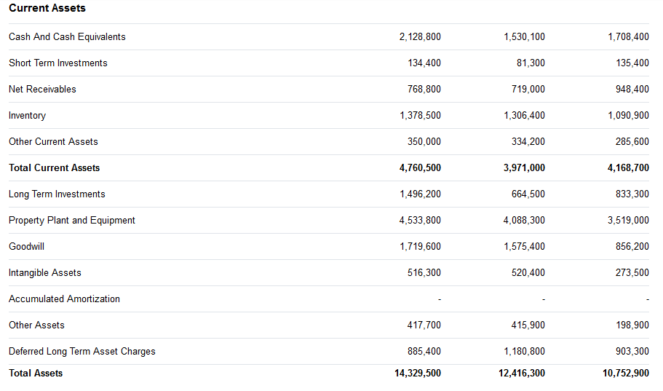
AREC 213 Lecture 7
Balance Sheet
Assets
Starbucks

Slide 14
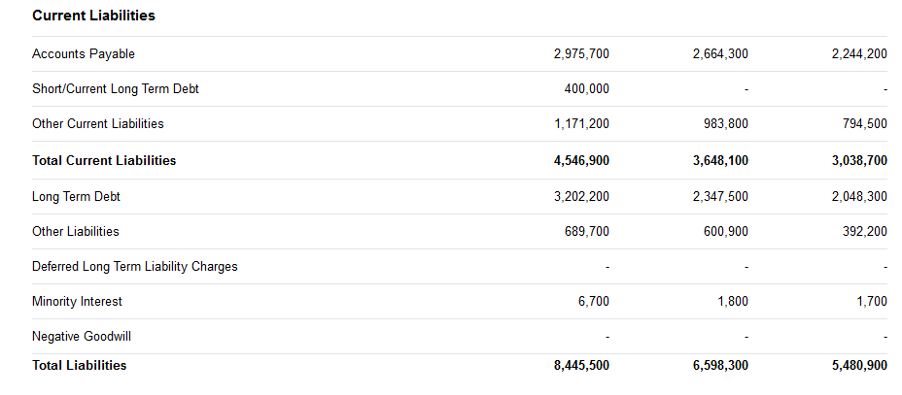
AREC 213 Lecture 7
Balance Sheet
Liabilities
Starbucks

Slide 15
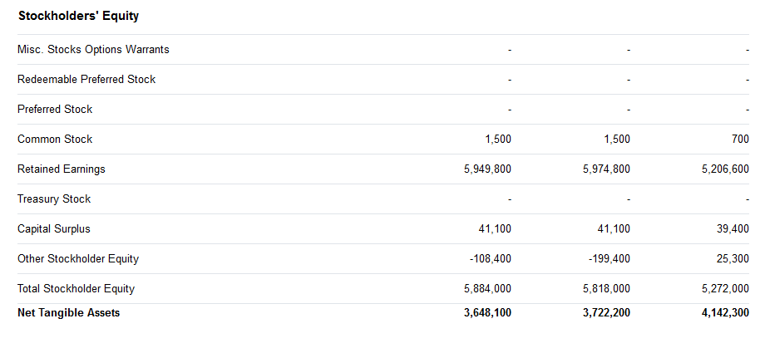
AREC 213 Lecture 7
Balance Sheet
Owner’s Equity
Or Stockholder’s Equity
Starbucks

Slide 16
Statement of Cash Flows

Slide 17
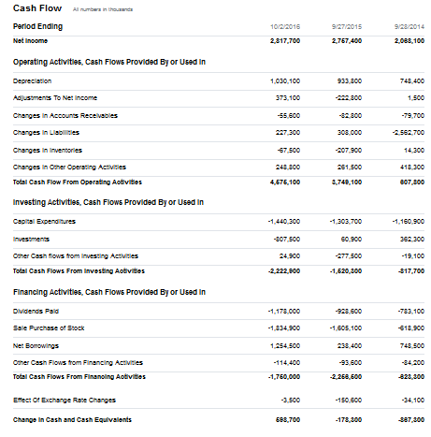
AREC 213 Lecture 7
Statement of Cash Flows
The Exchange of Money between the company and the outside world
Over a period of time
Three Main Areas
Operations
Investing
Finance
Starbucks

Slide 18
Income Statement

Slide 19
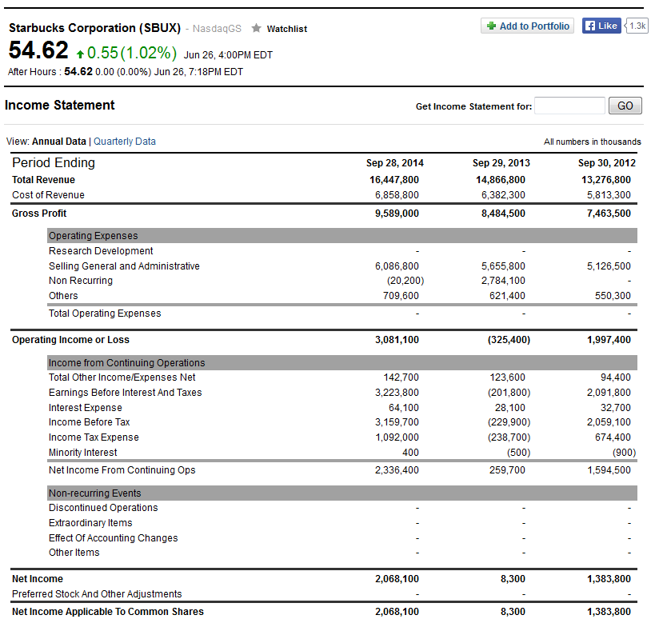
AREC 213 Lecture 7
Income Statement
How much a company made
How much a company Spent
Over a Period of Time
Starbucks

Slide 20
Example: Apple

Slide 21
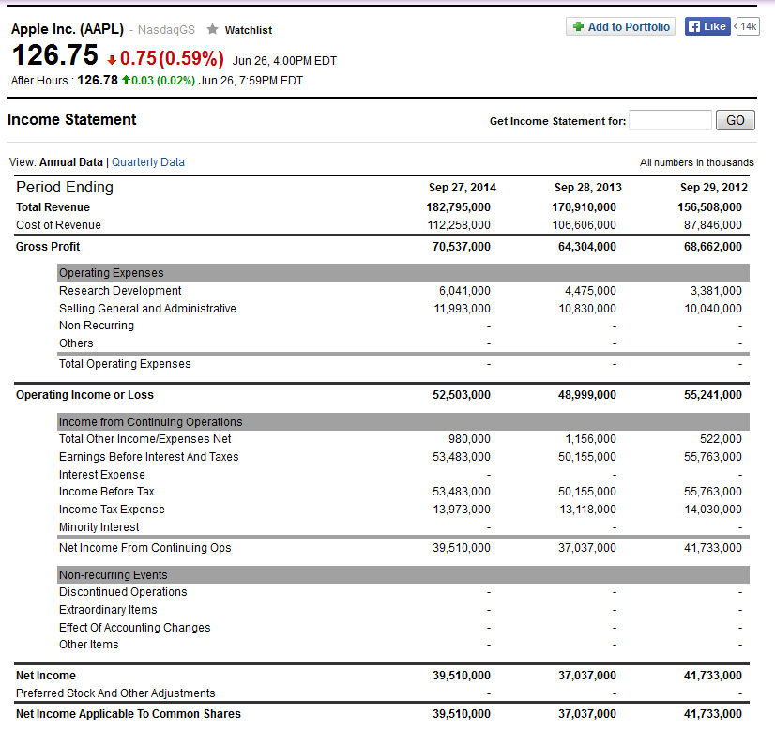
AREC 213 Lecture 7
Income Statement

Slide 22
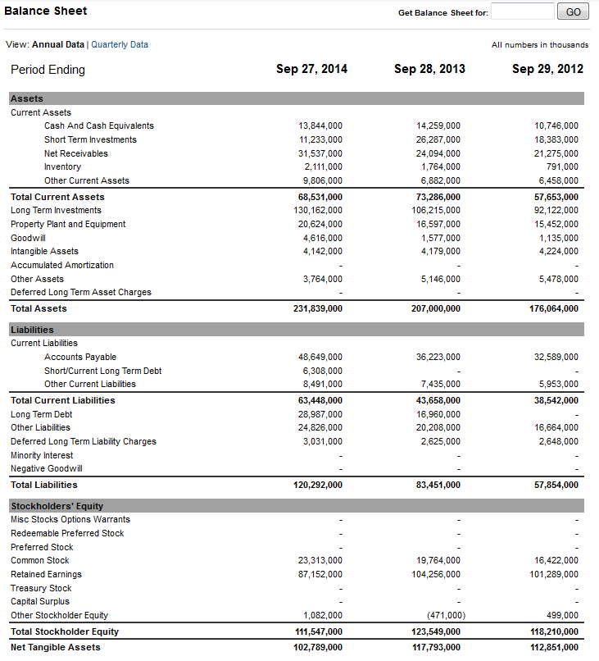
AREC 213 Lecture 7
Balance Sheet

Slide 23
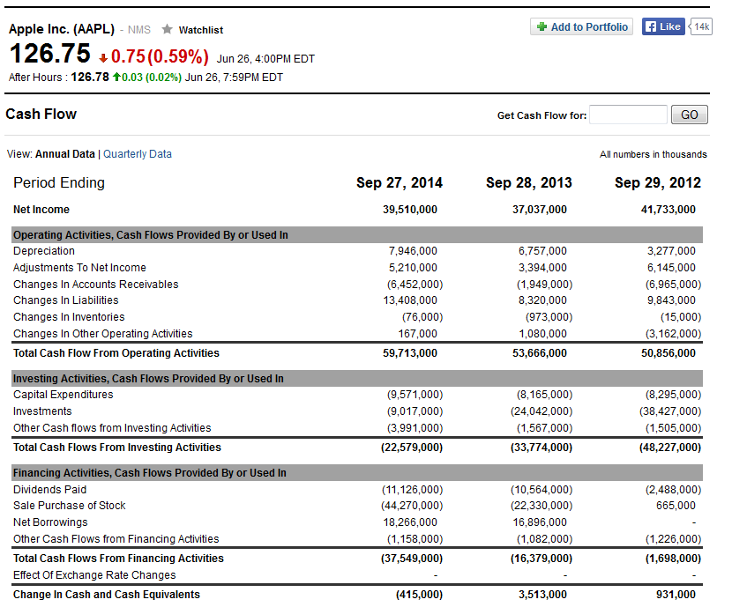
AREC 213 Lecture 7
Statement of Cash Flows

Slide 24
Financial Ratios

Slide 25
AREC 213- Lecture 7
Financial Ratios
Depict relationships between items on a firm’s financial statements.
An analysis of its financial ratios helps a firm determine whether it is meeting its financial objectives and how it stacks up against industry peers.

Slide 26
AREC 213- Lecture 7
Ratio Analysis
A practical way to interpret or make sense of a firm’s historical financial statements is through ratio analysis
Comparing a Firm’s Financial Results to Industry Norms
Comparing a firm’s financial results to industry norms helps a firm determine how it stacks up against its competitors and if there are any financial “red flags” requiring attention.

Slide 27
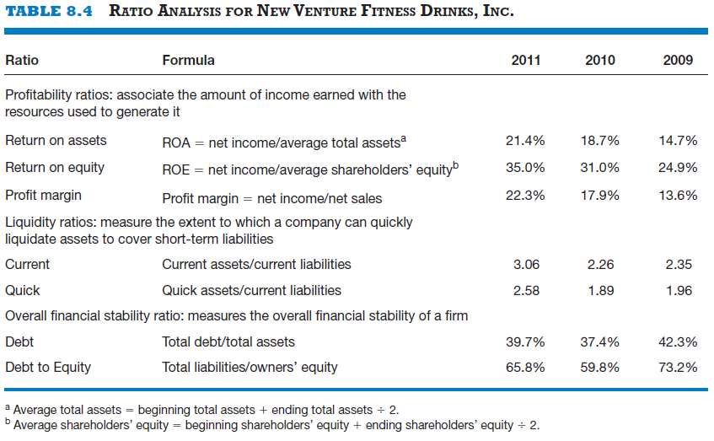
AREC 213- Lecture 7
Notes:
The quick ratio is those assets that can be converted within 90 days

Slide 28
Looking into the Future

Slide 29
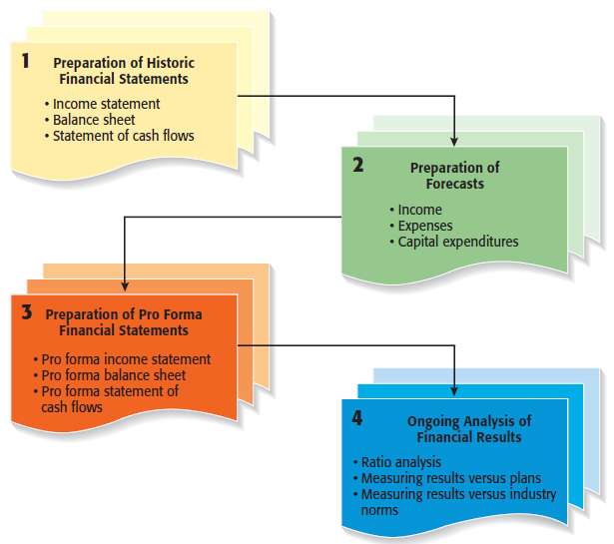
AREC 213- Lecture 7

Slide 30
AREC 213- Lecture 7
Historical Financial Statements
Reflect past performance and are usually prepared on a quarterly and annual basis.
Publicly traded firms are required by the SEC to prepare financial statements and make them available to the public.
Pro Forma Financial Statements
Are projections for future periods based on forecasts and are typically completed for two to three years in the future.
Pro forma financial statements are strictly planning tools and are not required by the SEC.
Notes:
Pro Forma- Also can be internal and not looking forward

Slide 31
AREC 213- Lecture 7
Forecasts
The analysis of a firm’s historical financial statements are followed by the preparation of forecasts.
Forecasts are predictions of a firm’s future sales, expenses, income, and capital expenditures.
A firm’s forecasts provide the basis for its pro forma financial statements.
A well-developed set of pro forma financial statements helps a firm create accurate budgets, build financial plans, and manage its finances in a proactive rather than a reactive manner.

Slide 32
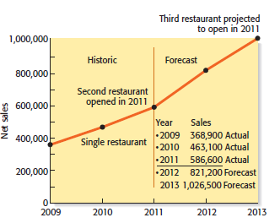
AREC 213- Lecture 7
Sales Forecast
A sales forecast is a projection of a firm’s sales for a specified period (such as a year).
It is the first forecast developed and is the basis for most of the other forecasts.
A sales forecast for a new firm is based on a good-faith estimate of sales and on industry averages or the experiences of similar start-ups.
A sales forecast for an existing firm is based on (1) its record of past sales, (2) its current production capacity and product demand, and (3) any factors that will affect its future product capacity and product demand.

Slide 33
AREC 213- Lecture 7
Forecast of Costs of Sales and Other Items
Once a firm has completed its sales forecast, it must forecast its cost of sales (or cost of goods sold) and the other items on its income statement.
The most common way to do this is to use the percentage-of-sales method, which is a method for expressing each expense item as a percentage of sales.
If a firm determines that it can use the percent-of-sales method and it follows the procedures described in the textbook, then the net result is that each expense item on its income statement will grow at the same rate as sales (with the exception of items that can be individually forecast, such as depreciation).

Slide 34
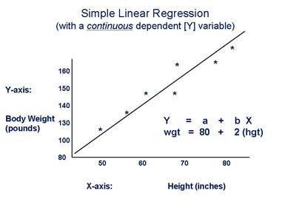

AREC 213- Lecture 7
Forecasting Tools
Regression Analysis (Simple and Multiple)
Some questions of interest include how would you build your model, what is important to include and what is not

Slide 35
AREC 213- Lecture 7
Pro Forma (Future) Financial Statements
A firm’s pro forma financial statements are similar to its historical financial statements except that they look forward rather than track the past.
The preparation of pro form financial statements helps a firm rethink its strategies and make adjustments if necessary.
The preparation of pro forma financials is also necessary if a firm is seeking funding or financing.

Slide 36
AREC 213- Lecture 7
Financial Statement
Purpose
Pro Forma Income Statement
Shows the projected results of the operations of a firm over a specific period.
Shows a projected snapshot of a company’s assets, liabilities, and owner’s equity at a specific point in time.
Pro Forma Balance Sheet
Pro Forma Statement of Cash flows
Shows the projected flow of cash into and out of a company for a specific period.

